Slide 1

מבנה – MICROCONTROLER
במחשב MIPS (PIC32 (
בטכנולוגיה RISC
תוכנת אסמבלי ל-pic 32
שם המרצה: ד"ר מנחם אפשטיין

Slide 2
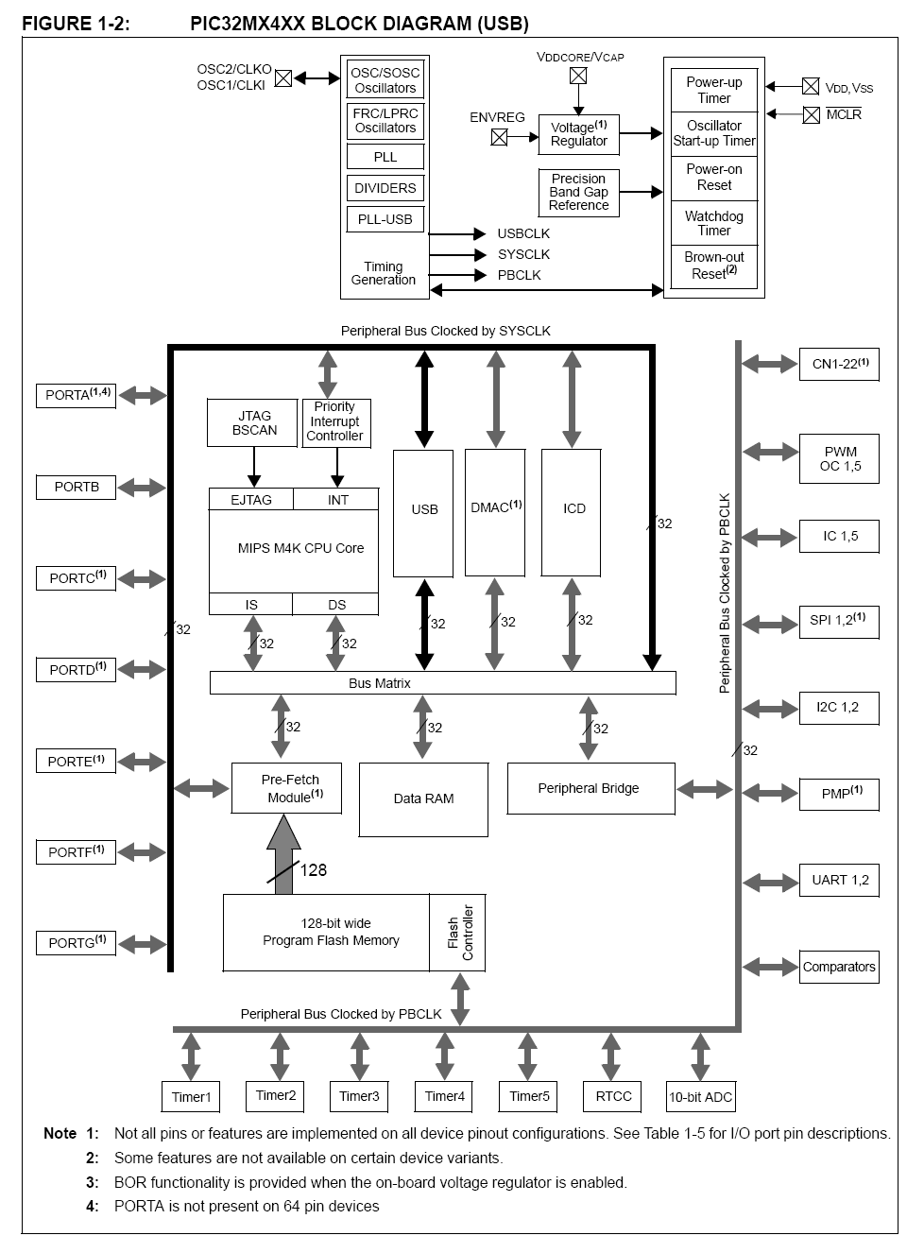
Comparator Negative Input
Input Capture Inputs

Slide 3
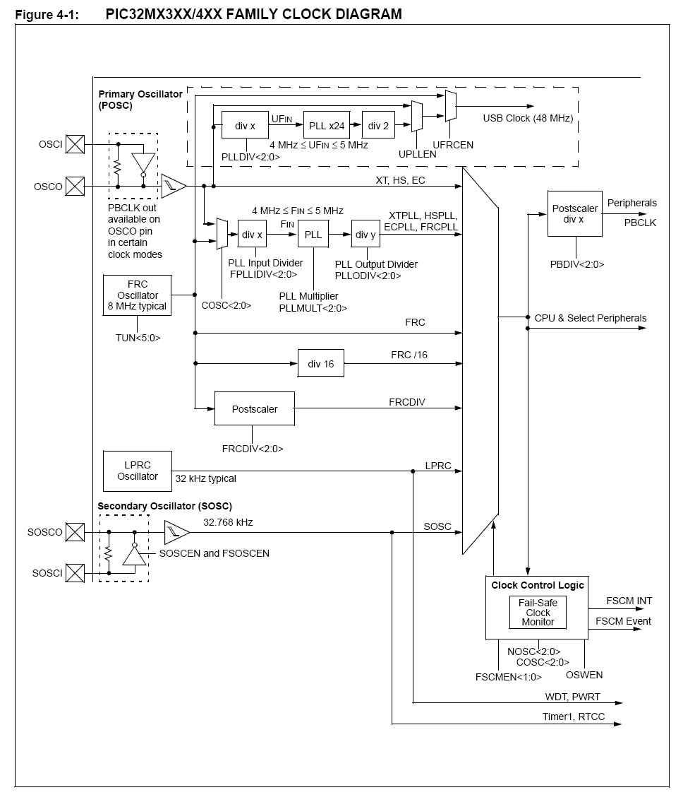

Slide 4
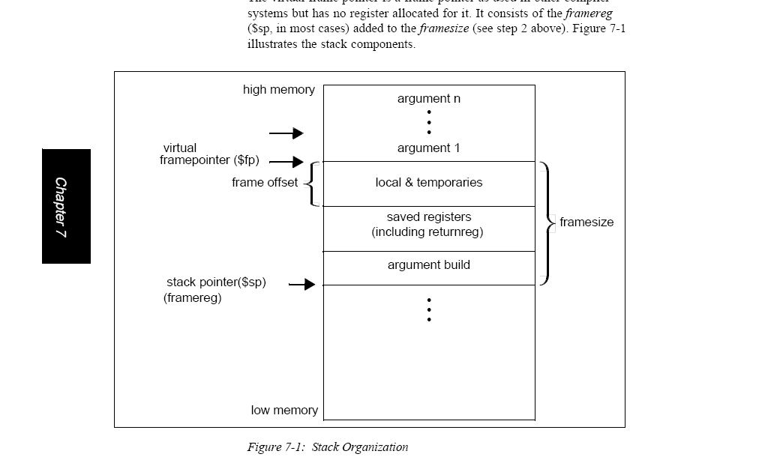

Slide 5
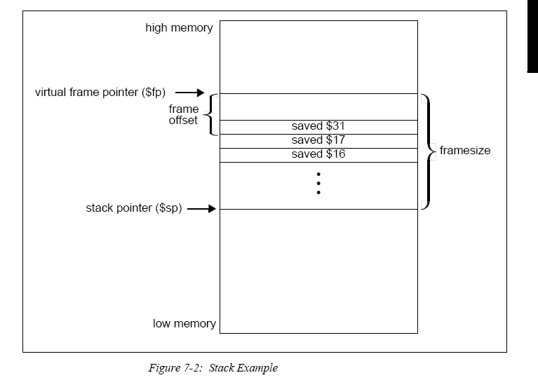

Slide 6
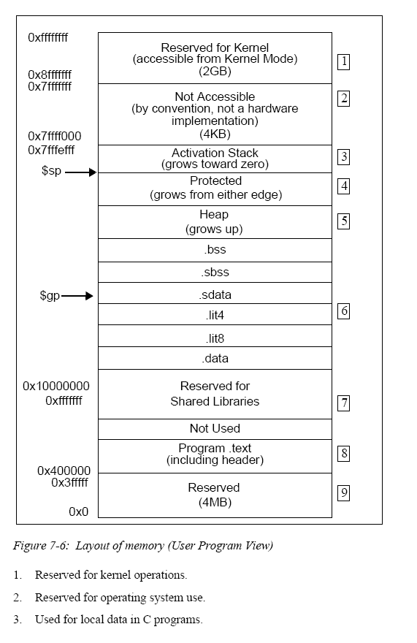

Slide 7
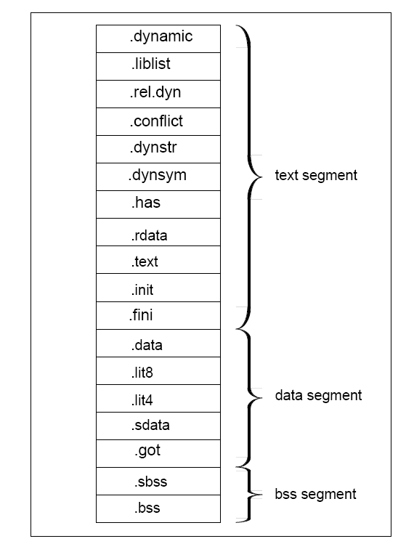

Slide 8
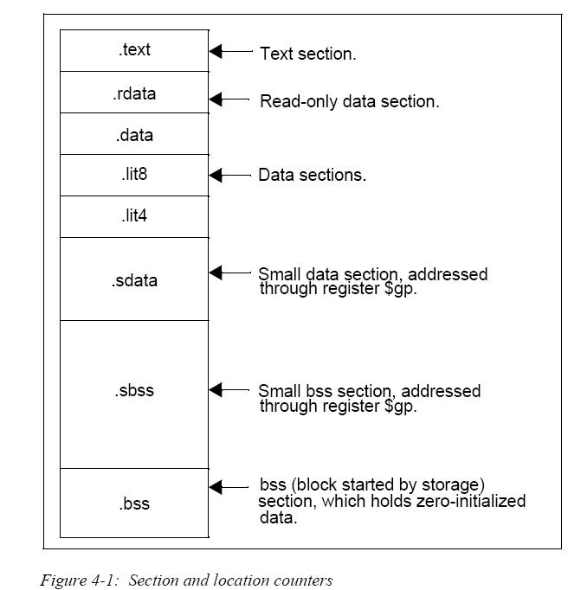
קטגוריה זו דומה לנתונים, חוץ מזה הגדרת סמל בעוד
. sdata ( "נתונים קטן") pseudo-op הוא למעשה גורם מקשר למקום זה
בתוך אזור 64k בתים הצביע על ידי הקופה $ GP, כך
מאסף יכול להשתמש חסכוני 16 סיביות לגשת אליו.

Slide 9
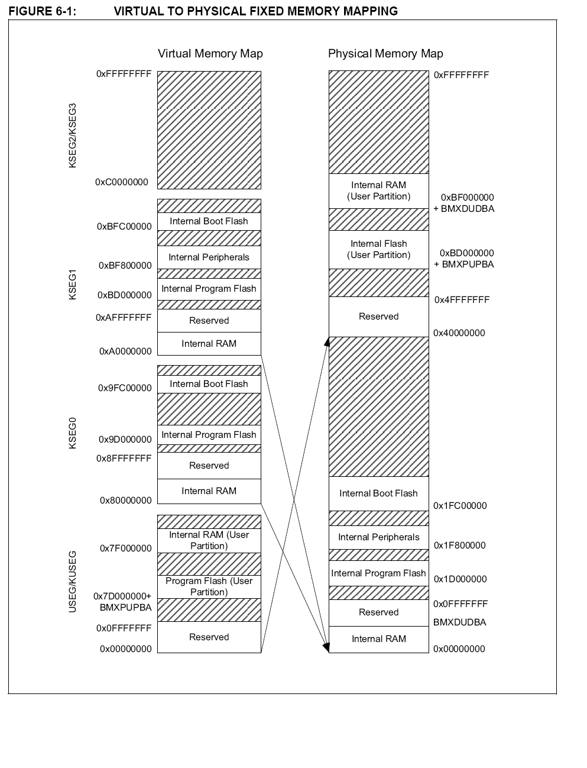

Slide 10
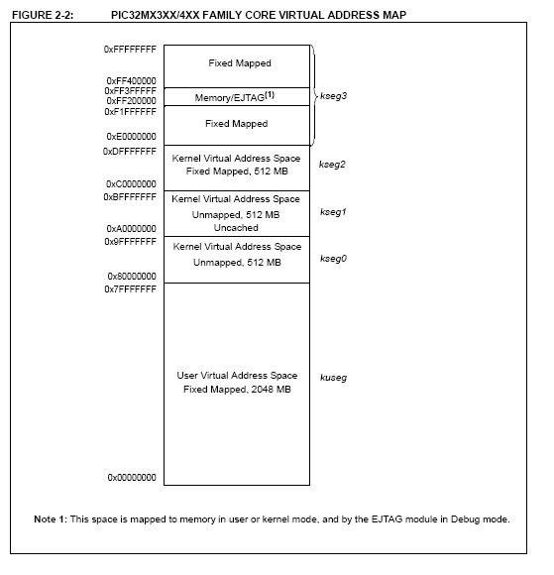

Slide 11
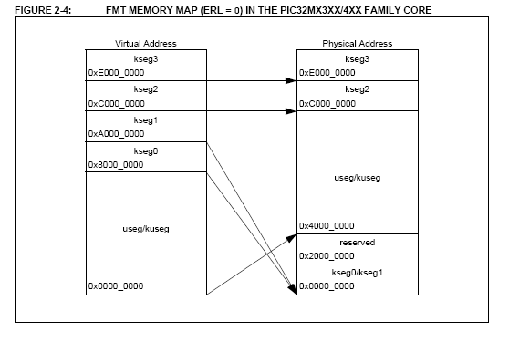

Slide 12
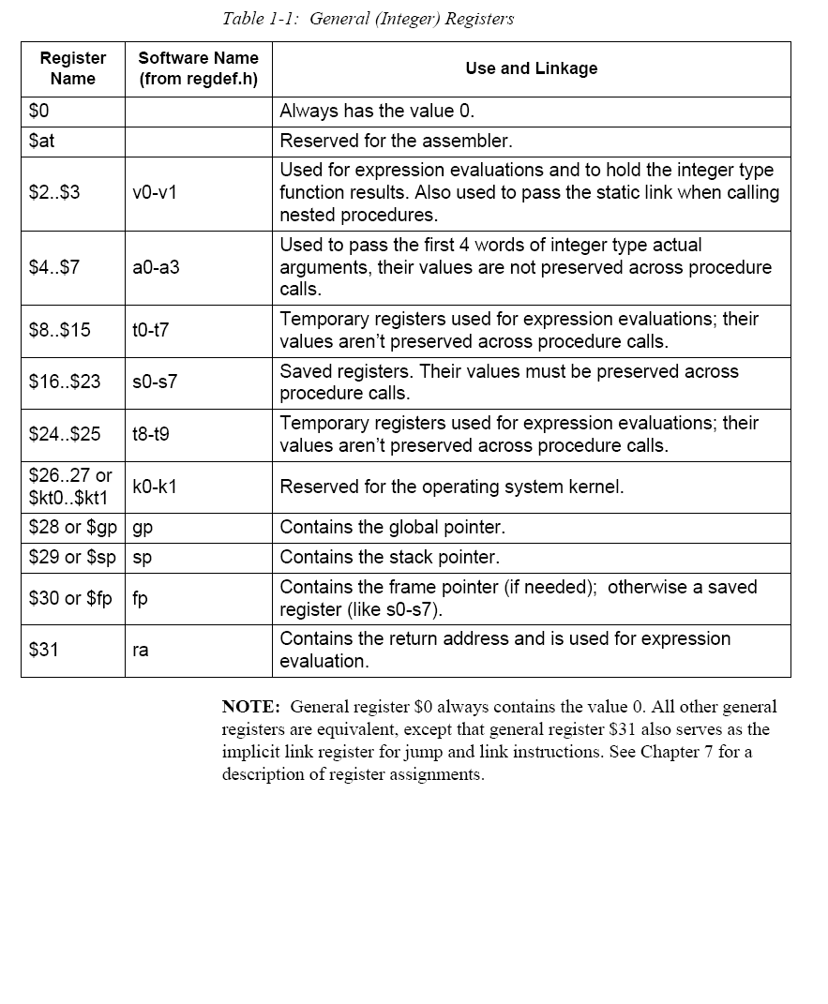

Slide 13
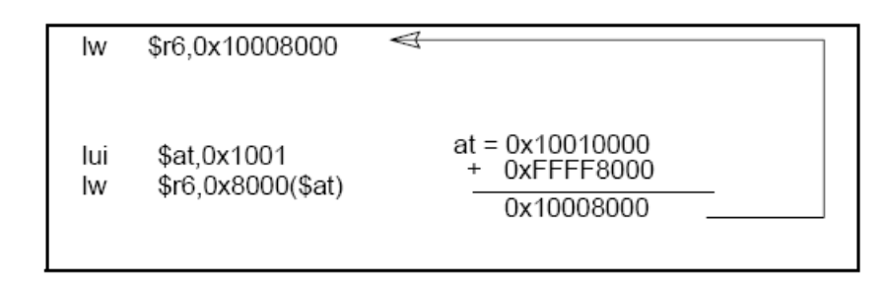
תפקיד הרגיסטרים הפנימיים
PIC 32
$0-תמיד יש את הערך 0.
$at- שמור לפעולת אסמבלר.-מצביע לקביעת כתובת בזיכרון
$2-$3)-v0-v1)
משמש הערכות הביטוי להחזיק את סוג שלם (int). כמו כן נעשה שימוש כדי להעביר את הקישור סטטי כאשר קוראים פונקציות מקוננות.
$4-$7)-a0-a3)
משמש כדי להעביר להחזיק משתנה מסוג 4- word
$8-$15)-t0-t7)
משתנה זמני.
פונקציה אינה מזהה את המשתנה.(מקומי לוקאלי )
$16-$23)-s0-s7)
אוגרים שמורים. הערכים שהפונקציה מזהה גלובלי .
$24-$25)-t8-t9)
משתנה זמני.
פונקציה אינה מזהה את המשתנה.(מקומי לוקאלי )
$26-$27)-kt0-kt1)
שמורות עבור הליבה של מערכת ההפעלה.
$28)-GP)
מכיל את המצביע הגלובלי
$29)-sp)
מכיל את המחסנית המצביע.
$30)-fp)
מכיל את המצביע –ניתן להשתמש (s0-s7)
$31)-ra)
מכיל את כתובת השולח

Slide 14
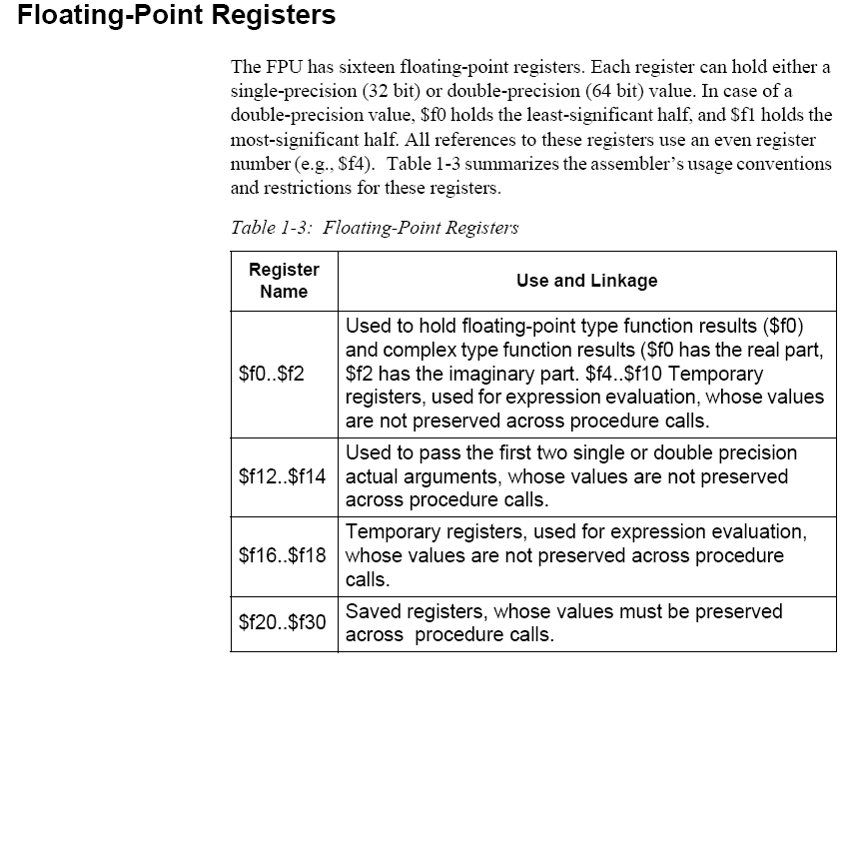

Slide 15
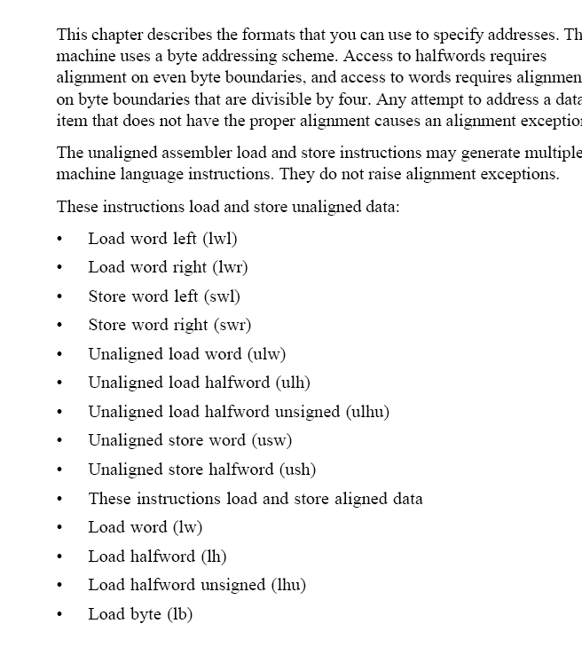

Slide 16
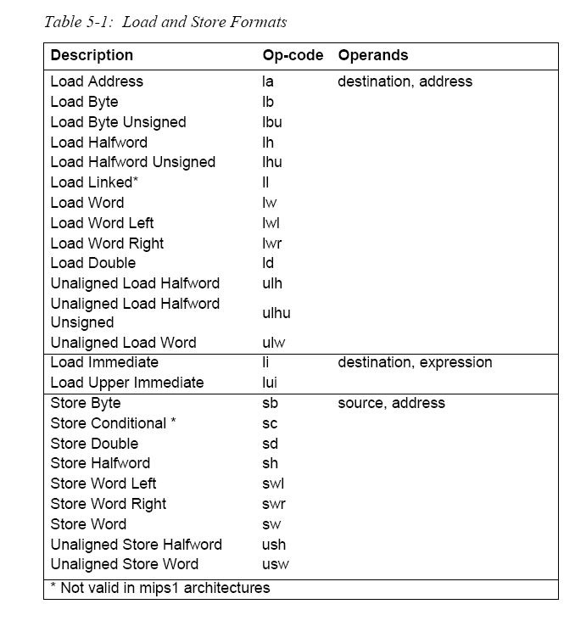

Slide 17
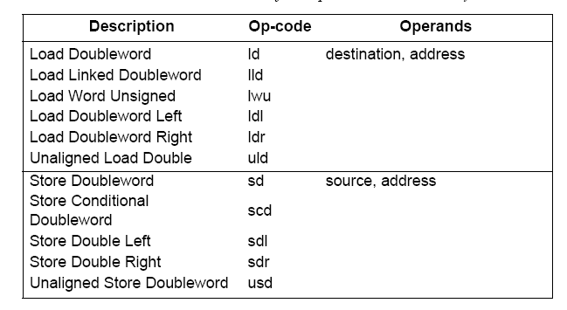

Slide 18
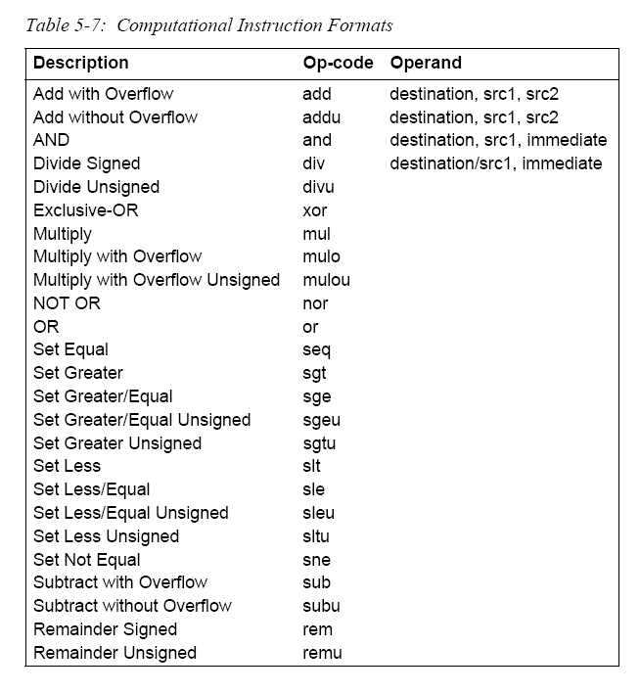

Slide 19
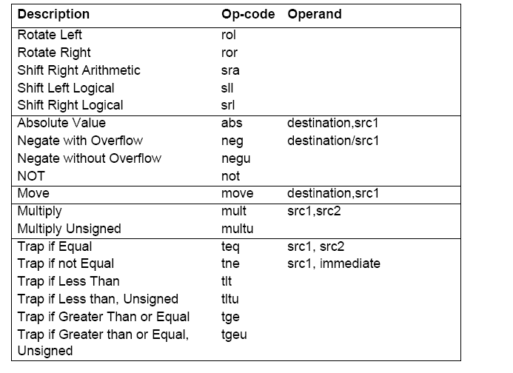

Slide 20
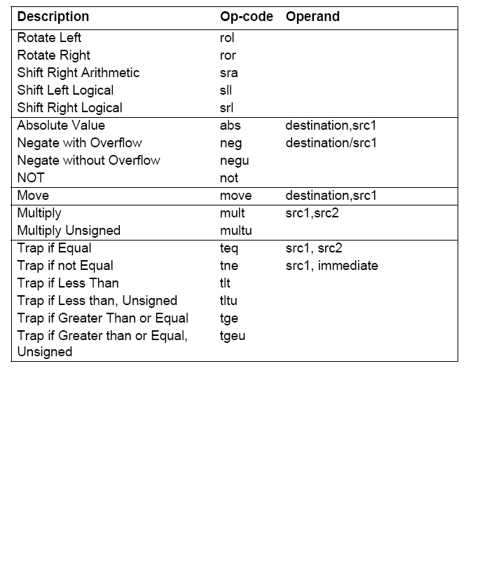

Slide 21
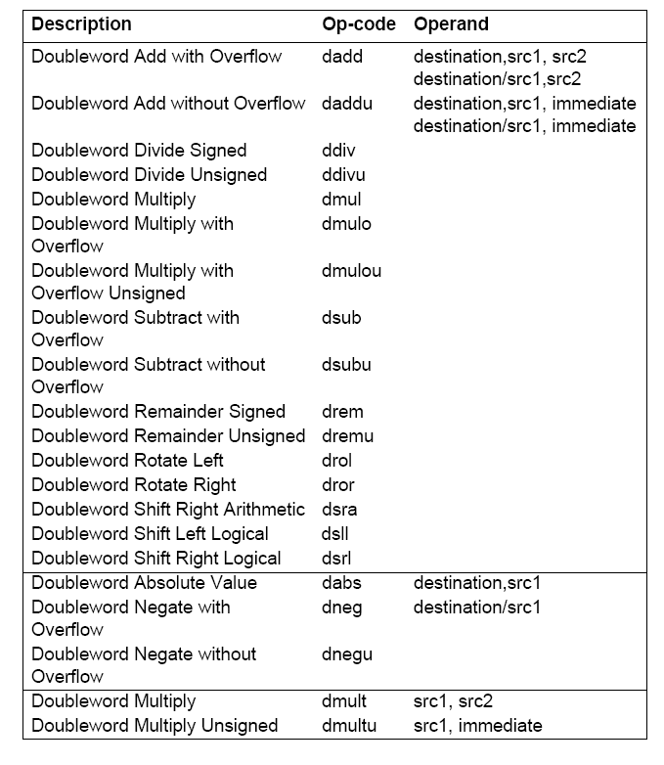

Slide 22
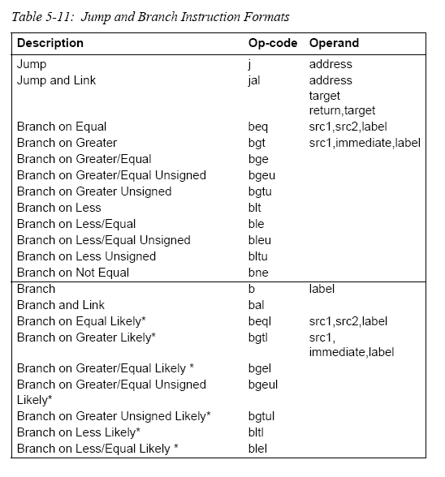

Slide 23
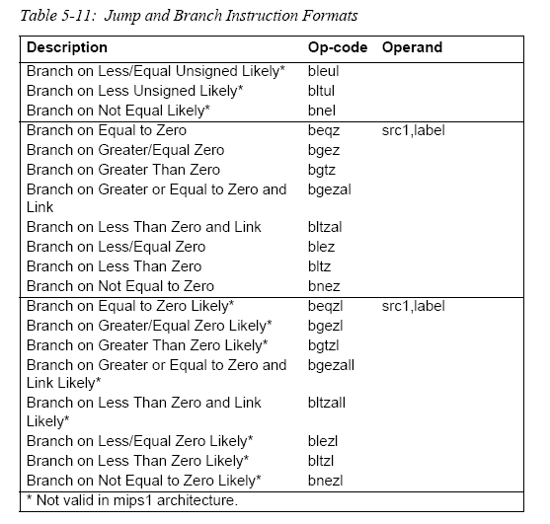

Slide 24
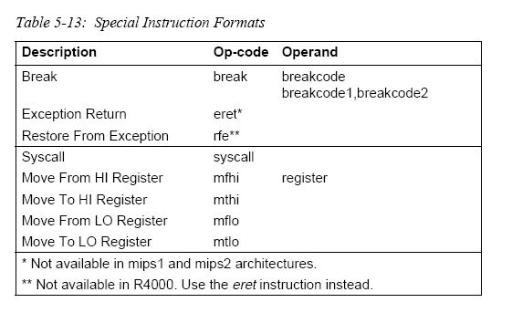

Slide 25
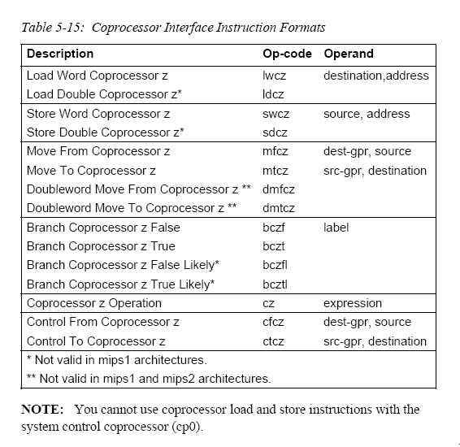

Slide 26
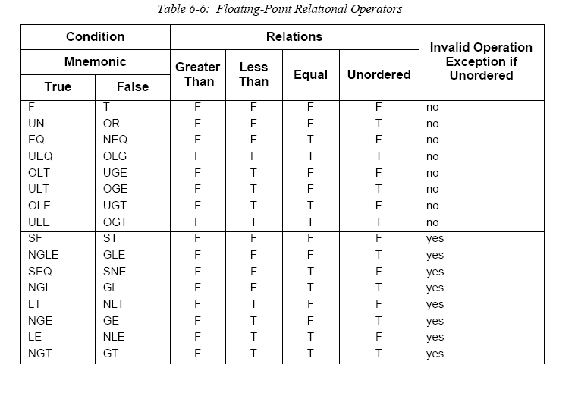

Slide 27
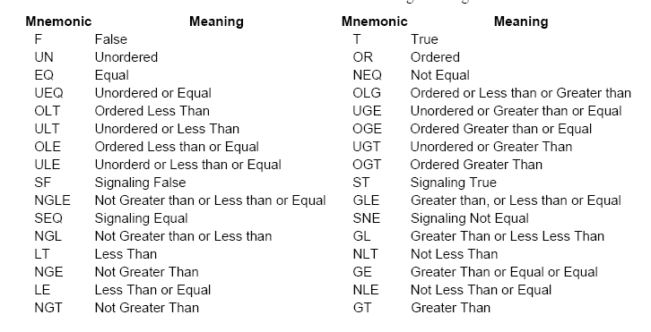

Slide 28
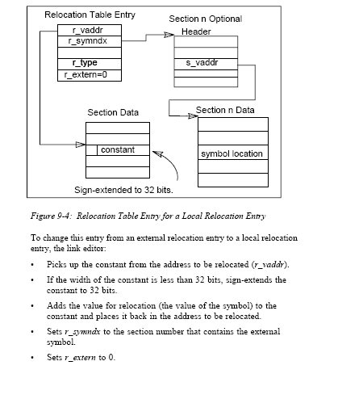
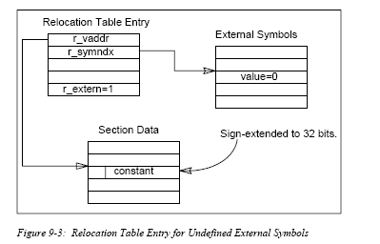

Slide 29
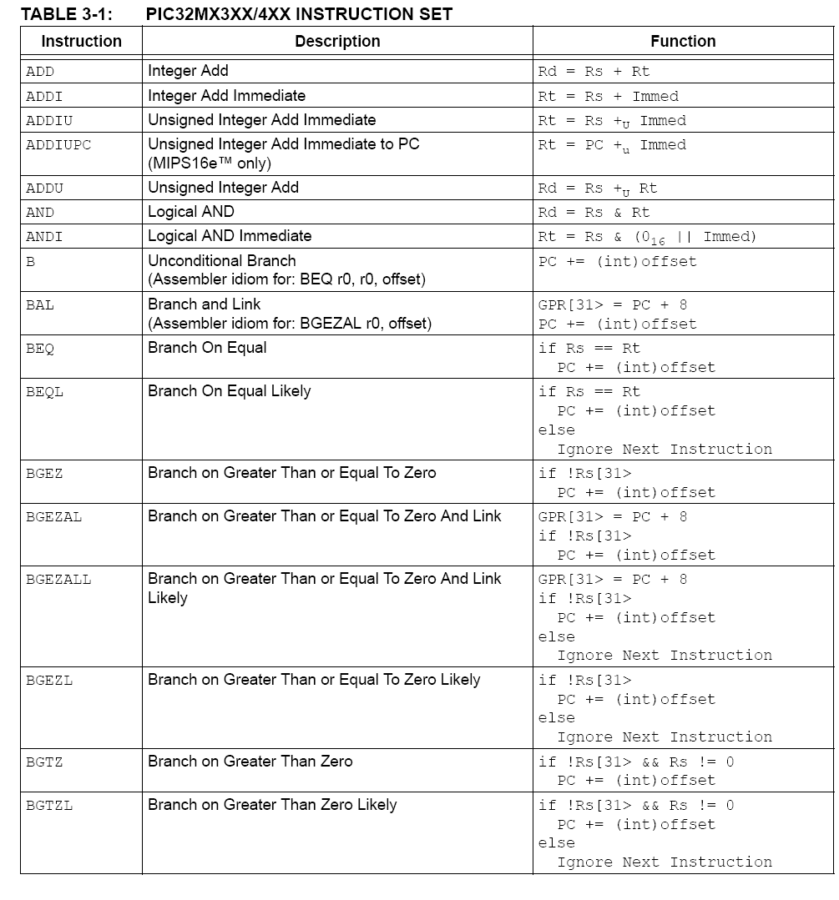

Slide 30
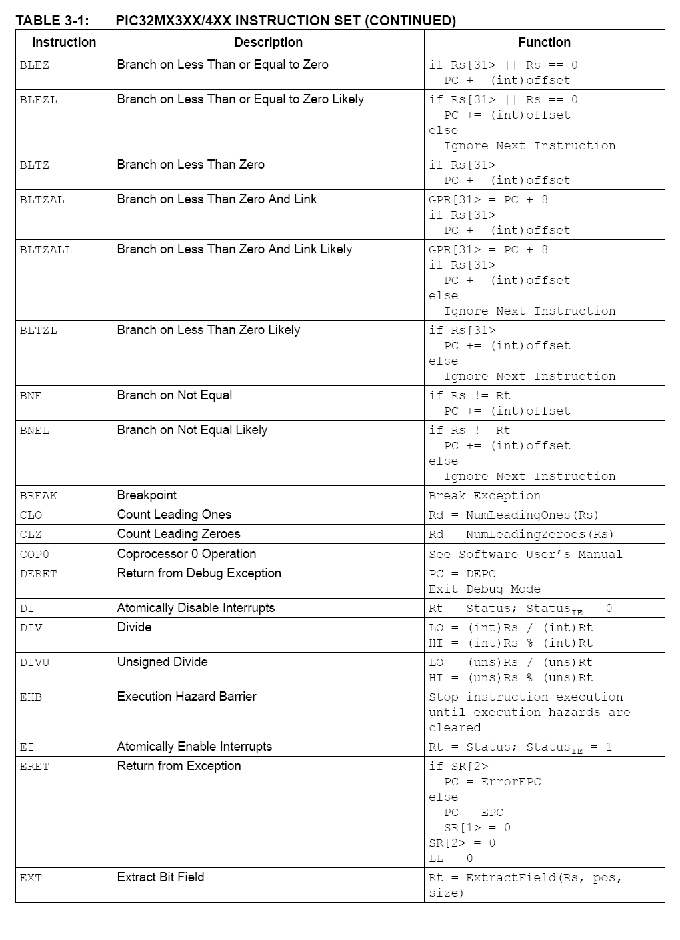

Slide 31
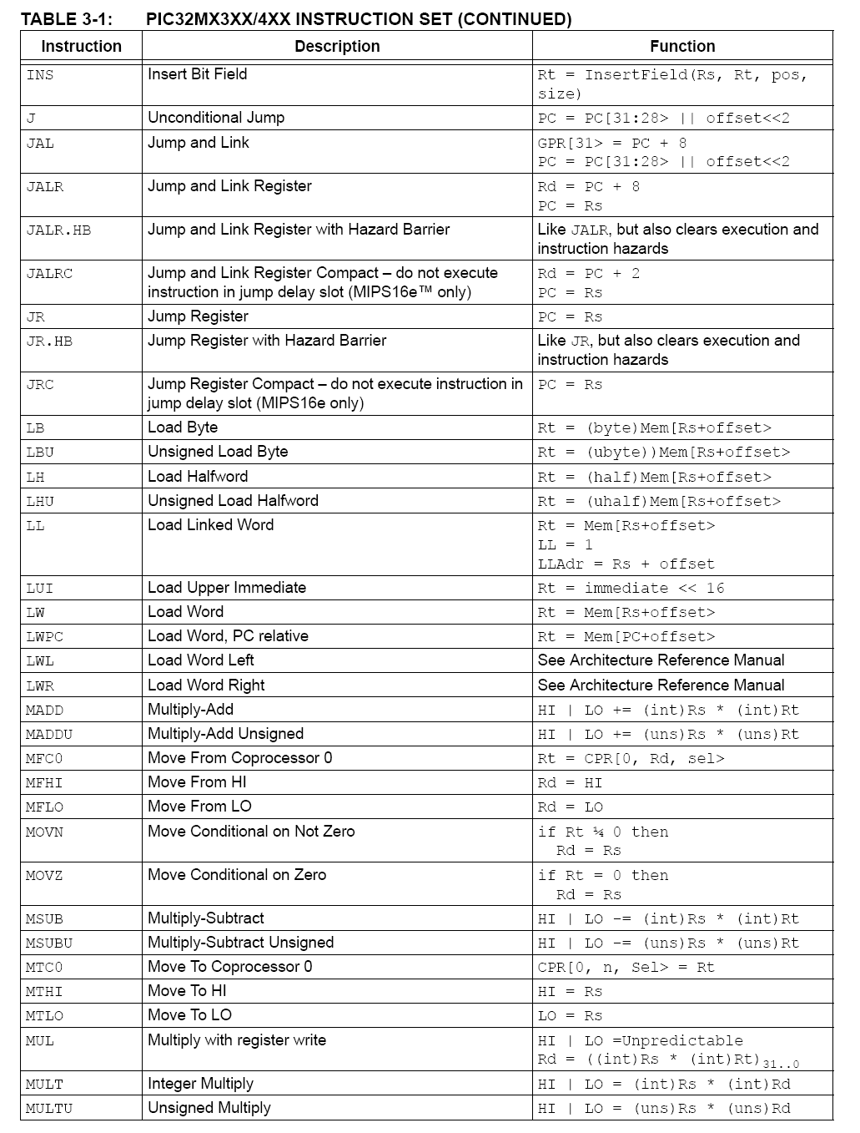

Slide 32
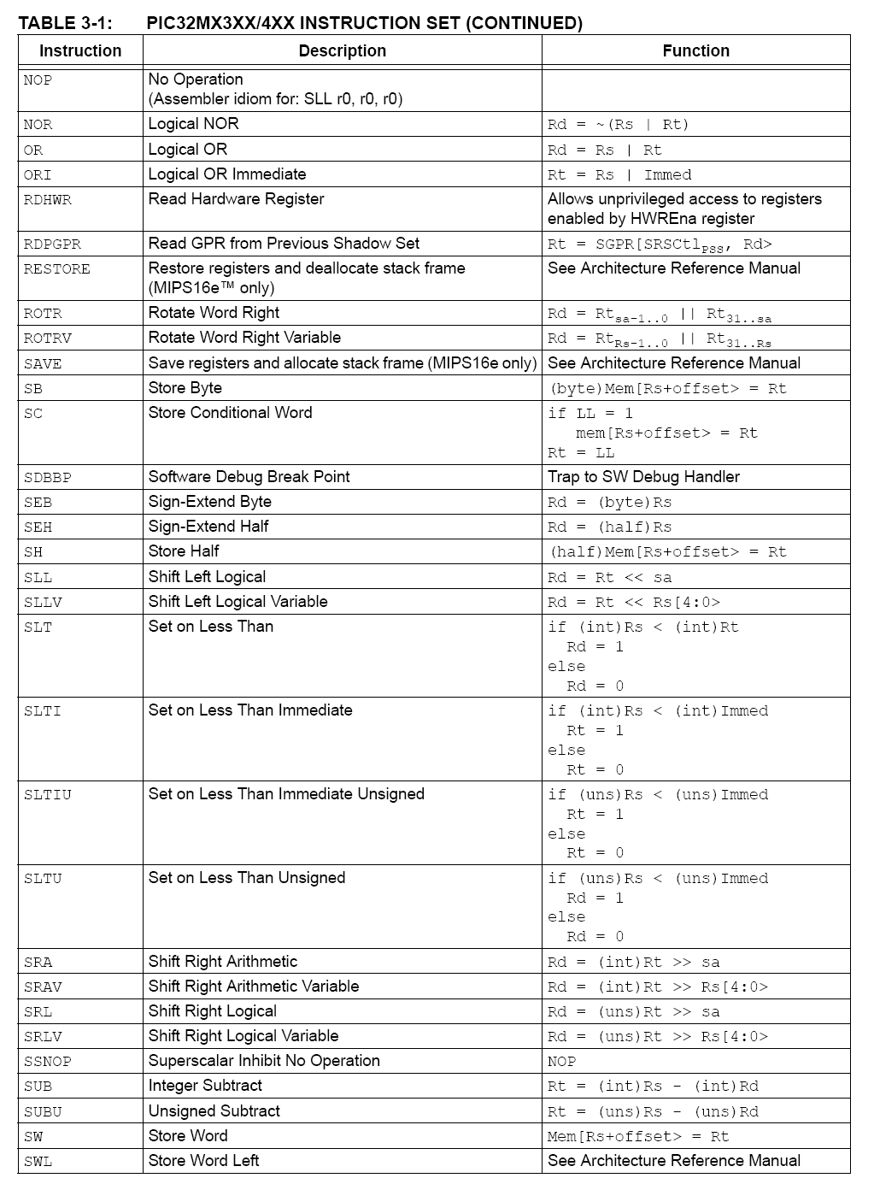

Slide 33
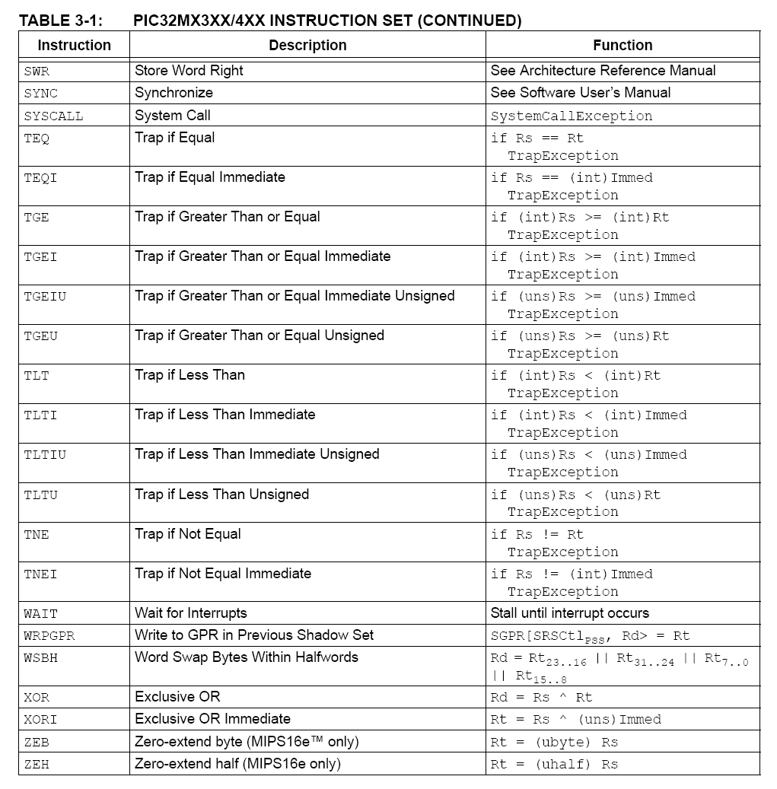

Slide 34
/*********************************************************************
*
* Example Assembly Project
*
*********************************************************************
* FileName: out_55_led.S
*
* Processor: PIC32MX
*
* Assembler/Compiler/Linker: MPLAB C32
*
* Company: Microchip Technology, Inc.
*
* Software License Agreement
*
*
********************************************************************/
#include <p32xxxx.h>
/* define all global symbols here */
.global main
/* define which section (for example "text")
* does this portion of code resides in. Typically,
* all your code will reside in .text section as
* shown below.
*/
.text
/* This is important for an assembly programmer. This
* directive tells the assembler that don't optimize
* the order of the instructions as well as don't insert
* 'nop' instructions after jumps and branches.
*/
.set noreorder
/*********************************************************************
* main()
* This is where the PIC32 start-up code will jump to after initial
* set-up.
********************************************************************/
.ent main /* directive that marks symbol 'main' as function in ELF
* output
*/
main:
nop
andi $s0,$s0,0
sw $s0,TRISF
sw $s0,TRISE
sw $s0,TRISD
ori $s0,$s0,0x4
sw $s0,PORTF
li $2,0x55
sw $2,PORTE
li $2,0x10
sw $2,PORTD
li $2,0x00
sw $2,PORTD
/* endless loop */
endless: j endless
nop
.end main /* directive that marks end of 'main' function and registers
* size in ELF output
*/

Slide 35
/*********************************************************************
*
* Example Assembly Project
*
*********************************************************************
* File Name: counter_up_led.S
*
* Processor: PIC32MX
*
* Assembler/Compiler/Linker: MPLAB C32
*
* Company: Microchip Technology, Inc.
*
* Software License Agreement
*
*
********************************************************************/
#include <p32xxxx.h>
/* define all global symbols here */
.global main
/* define which section (for example "text")
* does this portion of code resides in. Typically,
* all your code will reside in .text section as
* shown below.
*/
.text
/* This is important for an assembly programmer. This
* directive tells the assembler that don't optimize
* the order of the instructions as well as don't insert
* 'nop' instructions after jumps and branches.
*/
.set noreorder
/*********************************************************************
* main()
* This is where the PIC32 start-up code will jump to after initial
* set-up.
********************************************************************/
.ent main /* directive that marks symbol 'main' as function in ELF
* output
*/
#1

Slide 36
main:
nop
andi $s0,$s0,0
sw $s0,TRISF
sw $s0,TRISE
sw $s0,TRISD
ori $s0,$s0,0x4
sw $s0,PORTF
li $3,0
/* endless loop */
endless:
jal print
nop
addi $3,$3,1
jal delay
nop
j endless
nop
.end main /* directive that marks end of 'main' function and registers
* size in ELF output
*/
.ent delay
delay:
andi $s1,$s1,0
andi $s2,$s2,0
ori $s2,$s2,0xffff
x: addi $s1,$s1,1
bne $s1,$s2,x
nop
/* return to caller */
jr $ra
nop
.end delay
#2
.ent print
print:
sw $3,PORTE
li $2,0x10
sw $2,PORTD
li $2,0x00
sw $2,PORTD
/* return to caller */
jr $ra
nop
.end print

Slide 37
/*********************************************************************
*
* Example Assembly Project
*
*********************************************************************
* FileName: fan_led.S
*
* Processor: PIC32MX
*
* Assembler/Compiler/Linker: MPLAB C32
*
* Company: Microchip Technology, Inc.
*
* Software License Agreement
*
*
********************************************************************/
#include <p32xxxx.h>
/* define all global symbols here */
.global main
.global num
/* define all global symbols here */
.data
num:
.byte 0x81,0x42,0x24,0x18
/* define which section (for example "text")
* does this portion of code resides in. Typically,
* all your code will reside in .text section as
* shown below.
*/
.text
/* This is important for an assembly programmer. This
* directive tells the assembler that don't optimize
* the order of the instructions as well as don't insert
* 'nop' instructions after jumps and branches.
*/
.set noreorder
#1

Slide 38
/*****************************************************************
* main()
* This is where the PIC32 start-up code will jump to after initial
* set-up.
********************************************************************/
.ent main /* directive that marks symbol 'main' as function in ELF
* output
*/
main:
nop
andi $s0,$s0,0
sw $s0,TRISF
sw $s0,TRISE
sw $s0,TRISD
ori $s0,$s0,0x4
sw $s0,PORTF
start:
li $s0,0x0
la $s4,num
st_1: /* endless loop */
lb $3,($s4)
jal print #out_led_fan
nop
jal delay
nop
addi $s4,$s4,1
addi $s0,$s0,1
bne $s0,4,st_1
nop
j start
nop
.end main /* directive that marks end of 'main' function and registers
* size in ELF output
*/
.ent delay
delay:
andi $s1,$s1,0
andi $s2,$s2,0
ori $s2,$s2,0xffff
x: addi $s1,$s1,1
bne $s1,$s2,x
nop
/* return to caller */
jr $ra
nop
.end delay
.ent print
print:
sw $3,PORTE
li $2,0x10
sw $2,PORTD
li $2,0x00
sw $2,PORTD
/* return to caller */
jr $ra
nop
.end print
#2

Slide 39
/*********************************************************************
*
* Example Assembly Project
*
*********************************************************************
* File Name: SW_CONTER_UP_DOWN_LED.S
*
* Processor: PIC32MX
*
* Assembler/Compiler/Linker: MPLAB C32
*
* Company: Microchip Technology, Inc.
*
* Software License Agreement
*
*
********************************************************************/
#include <p32xxxx.h>
/* define all global symbols here */
.global main
/* define which section (for example "text")
* does this portion of code resides in. Typically,
* all your code will reside in .text section as
* shown below.
*/
.text
/* This is important for an assembly programmer. This
* directive tells the assembler that don't optimize
* the order of the instructions as well as don't insert
* 'nop' instructions after jumps and branches.
*/
.set noreorder
/*********************************************************************
* main()
* This is where the PIC32 start-up code will jump to after initial
* set-up.
********************************************************************/
.ent main /* directive that marks symbol 'main' as function in ELF
* output
*/
#1

Slide 40
main:
nop
andi $s0,$s0,0
sw $s0,TRISF
sw $s0,TRISD
li $7,1
li $3,0
/* endless loop */
start:
li $2,0xff
sb $2,TRISE
li $2,0x3
sb $2,PORTF
jal in_sw
nop
lb $2,PORTE
andi $2,$2,1
bne $2,1,down
nop
addi $3,$3,1
j sof
nop
down:
sub $3,$3,$7
sof:
jal print
nop
jal delay
nop
j start
nop
.end main /* directive that marks end of 'main' function and registers
* size in ELF output
*/
.ent delay
delay:
andi $s1,$s1,0
andi $s2,$s2,0
ori $s2,$s2,0xffff
x: addi $s1,$s1,1
bne $s1,$s2,x
nop
/* return to caller */
jr $ra
nop
.end delay
.ent print
print:
li $2,0x4
sw $2,PORTF
li $2,0
sw $2,TRISE
sw $3,PORTE
in_sw :
li $2,0x10
sw $2,PORTD
li $2,0x00
sw $2,PORTD
/* return to caller */
jr $ra
nop
.end print
#2

Slide 41
/*********************************************************************
*
* Example Assembly Project
*
*********************************************************************
* File Name: lcd_mes.S
*
* Processor: PIC32MX
*
* Assembler/Compiler/Linker: MPLAB C32
*
* Company: Microchip Technology, Inc.
*
* Software License Agreement
*
*
********************************************************************/
#include <p32xxxx.h>
/* define all global symbols here */
.global main
.global control
.global name
/* define all global symbols here */
.data
control:
.byte 0x38,0x38,0x38,0xe,0x6,0x1,'$'
name:
.ascii "MENACHEM EPSTEIN$"
/* define which section (for example "text")
* does this portion of code resides in. Typically,
* all your code will reside in .text section as
* shown below.
*/
.text
/* This is important for an assembly programmer. This
* directive tells the assembler that don't optimize
* the order of the instructions as well as don't insert
* 'nop' instructions after jumps and branches.
*/
.set noreorder
#1

Slide 42
/************************************************************************
* main()
* This is where the PIC32 start-up code will jump to after initial
* set-up.
********************************************************************/
.ent main /* directive that marks symbol 'main' as function in ELF
* output
*/
main:
nop
and $s0,$zero
sw $s0,TRISF
sw $s0,TRISE
sw $s0,TRISD
lw $s0,TRISB
andi $s0,$s0,0x7fff
sw $s0,TRISB
li $s0,0
sw $s0,PORTF
/* lcd control */
la $s4,control
lw $s5,PORTB
andi $s5,$s5,0x7fff
sw $s5,PORTB #RS=0 control RB15
jal print #output control char Lcd
nop
/* Lcd print_mes */
la $s4,name
li $5,0xffff
sw $5,PORTB #RS=1 data RB15
jal print #out_print_mes_lcd
nop
start:
j start
nop
.end main /* directive that marks end of 'main' function and registers
* size in ELF output
*/
#2
.ent print
print:
pr1: lb $3,($s4)
beq $3,'$',x1
nop
sw $3,PORTE
li $2,0x10
sw $2,PORTD
li $2,0x00
sw $2,PORTD
/* delay */
addi $s4,$s4,1
andi $s1,$s1,0
andi $s2,$s2,0
ori $s2,$s2,0xffff
x: addi $s1,$s1,1
bne $s1,$s2,x
nop
/* delay */
j pr1
nop
x1:
/* return to caller */
jr $ra
nop
.end print

Slide 43
END

